Slide 1
COVID MANAGEMENT SYSTEM
Apoorva Kethamaranahalli 001090928
Shreyas Chittlur Ramesh 001568012
Swaroop Gupta B A 001545134

Slide 2
PROBLEM STATEMENT
01
02
03
04
HEALTH
RISKS WITH TESTING
QUARANTINE FACILITY STATUS
PRIMARY CONTACT TRACING
HOSPITAL OVERBURDENED WITH RECORDS
Notes:
01: A hospital cannot manually maintain the records of patients who get tested on a daily basis for COVID19 at different testing centres across the city.
02: Multiple users turning up at the same testing centre can be a health risk.
03: It is difficult to manually track and maintain the status of quarantine facilities across the city
04: Tracing the primary contact of a person tested positive becomes an arduous task without a proper tracing system.

Slide 3
PROPOSED SOLUTIONS
TEST SCHEDULE
TESTING CENTERS
RISK STATUS
QUARANTINE FACILITY
Automatic real time update when user books a covid test
Users can book test at a range of test centers offered to them based on availability
Active updation of risk status of close contacts of a covid positive user.
Facility head can add and discharge covid positive patients from their respective facilities
Notes:
1. Every time a user schedules a COVID 19 test, his record is automatically updated in the TEST_SCHEDULE table
2. Users can book their tests based on the schedule availability at a particular testing center.
3. Based on the test results, a Test Center Head at the corresponding Test Center Location will be able to place the user(in case of a positive result) at the available quarantine facility. 4. If a user is tested positive, the primary contacts of that user can be traced using the staff timesheet and the test schedule data, after which a trigger is applied where the risk status of the user(s) is changed to reflect the same.

Slide 4
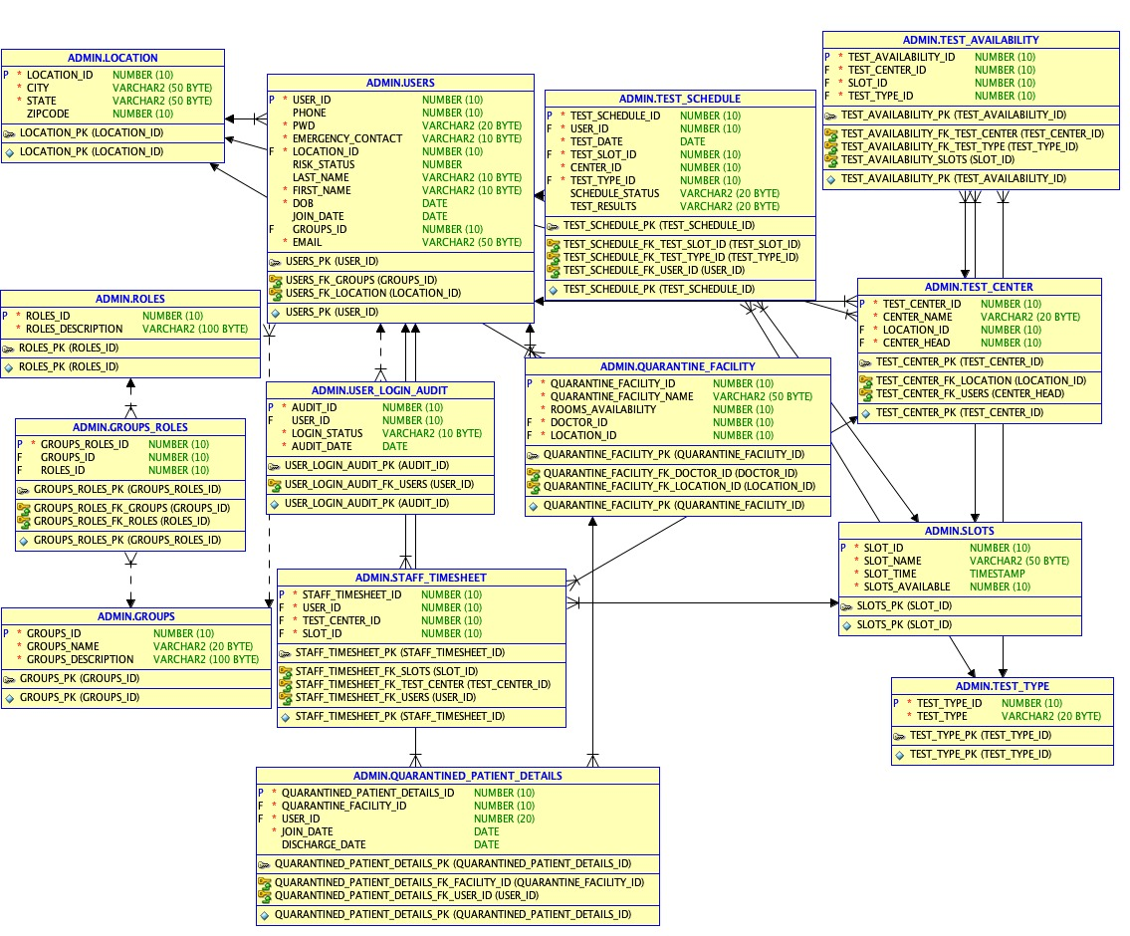
ER DIAGRAM

Slide 5
FEATURES
FUNCTIONS
PROCEDURES
INDEXES
TRIGGERS
CURSORS
USER ROLES
CUSTOMISED VIEWS
REPORTS

Slide 6
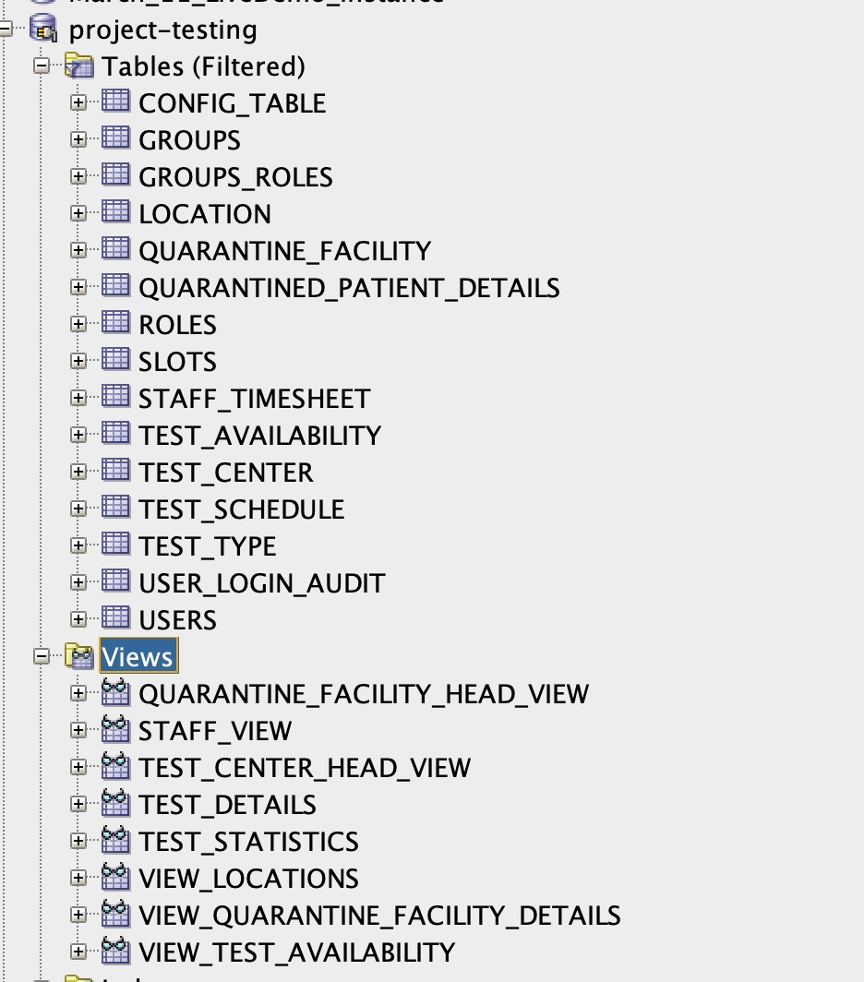
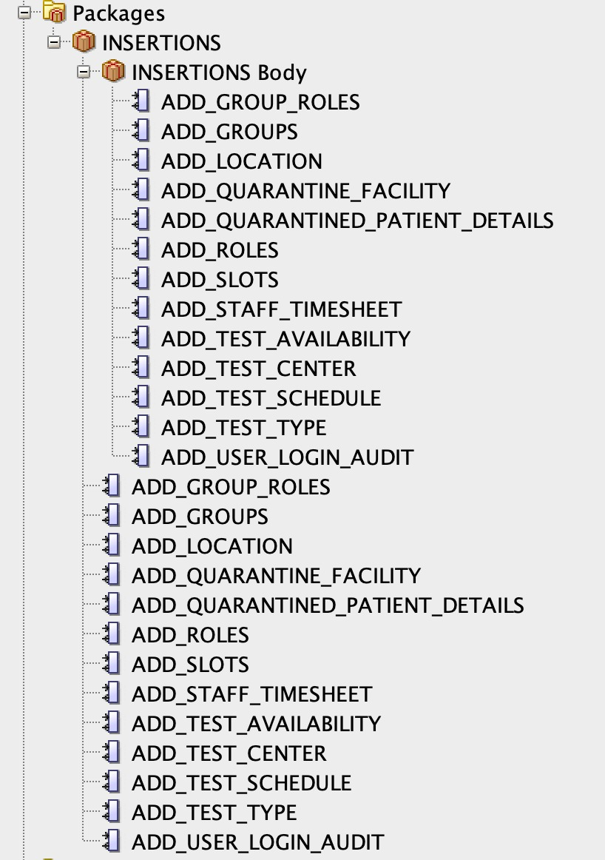
DB OBJECTS

Slide 7
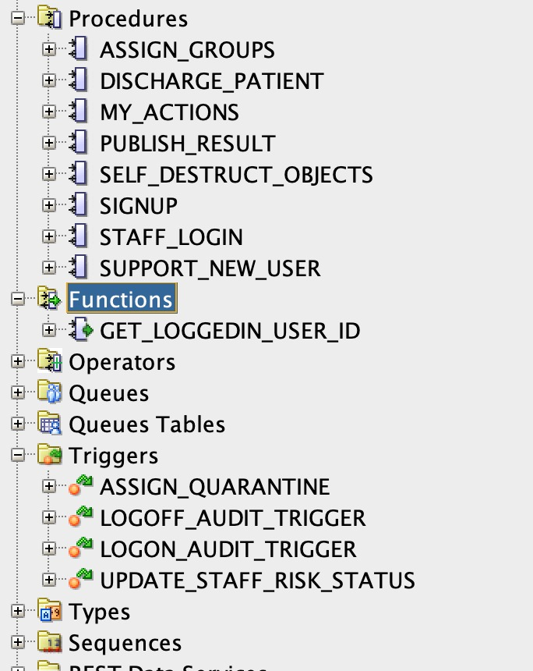
DB OBJECTS

Slide 8
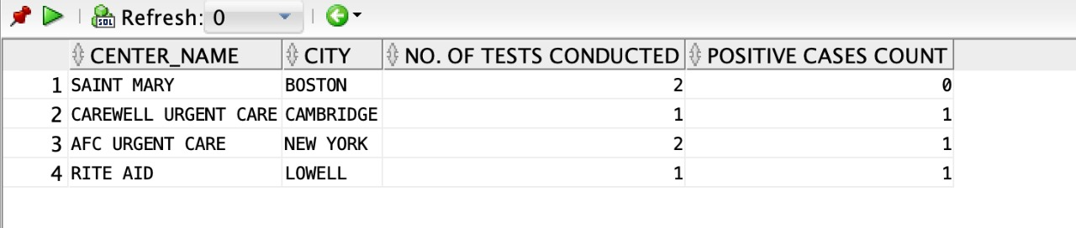
OVERALL TEST STATISTICS
We can get the overall test statistics based on the total number of tests conducted and the positive cases count of that test center

Slide 9
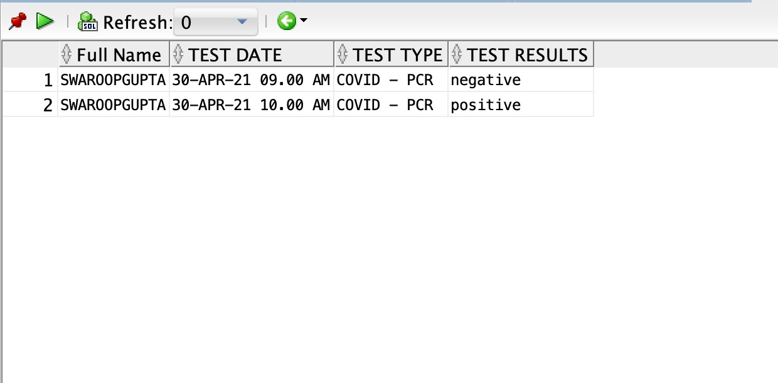
TEST RESULTS
Test results can be viewed for each of the test taken by a user as shown above.

Slide 10
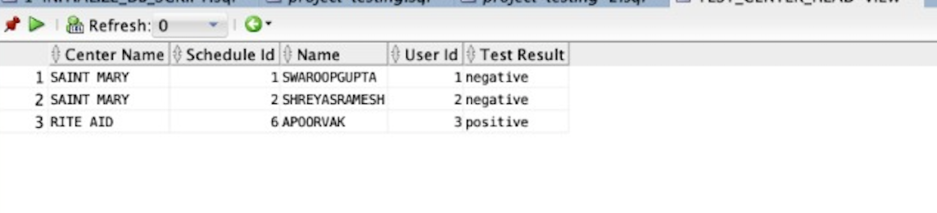
TEST CENTER HEAD VIEW
Test center head can view the reports of his test center which details the people and their test results at his particular test center

Slide 11
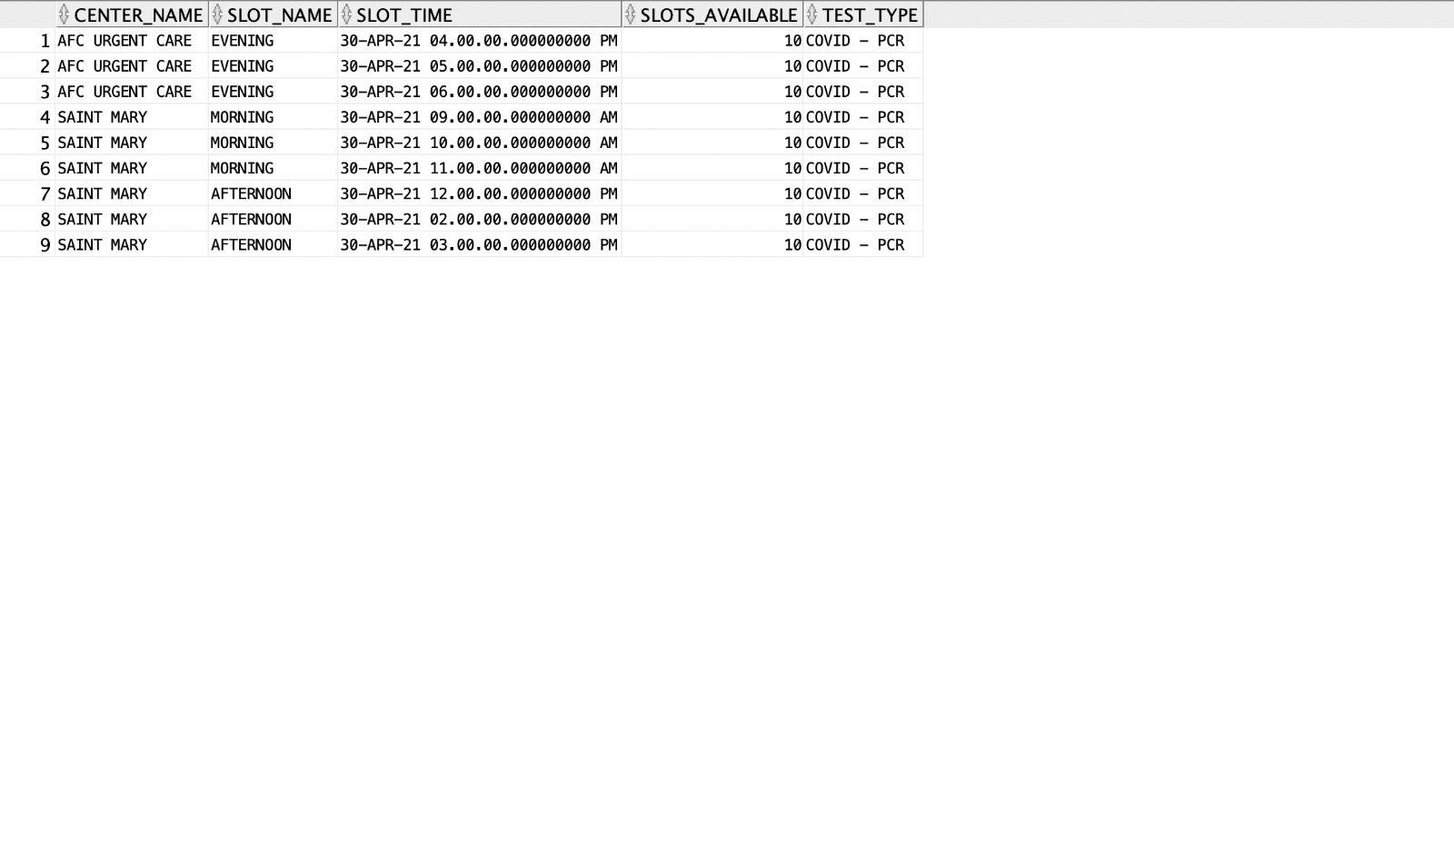
TEST SCHEDULE VIEW
The user can book a test by looking at the test schedule as shown above

Slide 12
CONTRIBUTIONS:
APOORVA KETHAMARANAHALLI : (MODULES ): Test schedule, test availability, user booking test
SHREYAS CHITTLUR RAMESH: (MODULES ):User cancelling test, staff login, center head managing each center
SWAROOP GUPTA B A (MODULES ):Signup process, quarantining triggers, doctor managing quarantined patients, updating risk status of positive patients

Slide 13

THANK YOU

